Slide 1
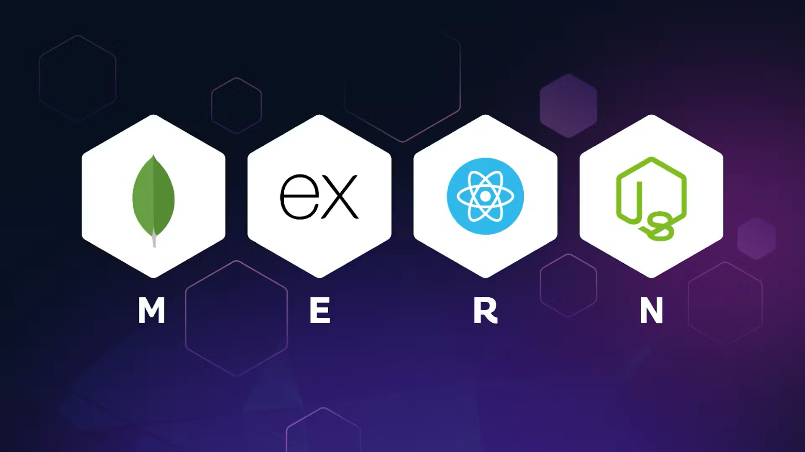
MERN Stack
By: Kushal Vaghela

Slide 2
Topic to be covered
Created React app using Vite
Create a Components
Added routing with React Router
Setup Node + Express backend
Describe Model
Implemented CRUD operations
Connecting Front-end to Back-end
By: Kushal Vaghela

Slide 3
Created React app using Vite
Create a react Application
npx create vite@latest my-app
Move in project
cd my-app
Install Dependency
npm I
Run an Application
npm run dev
By: Kushal Vaghela

Slide 4
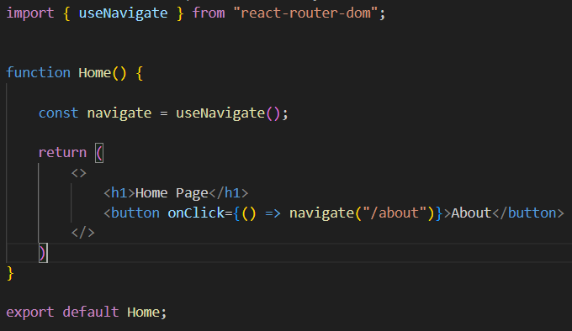
2. Create a Component
Create a component
Function or class
By: Kushal Vaghela

Slide 5
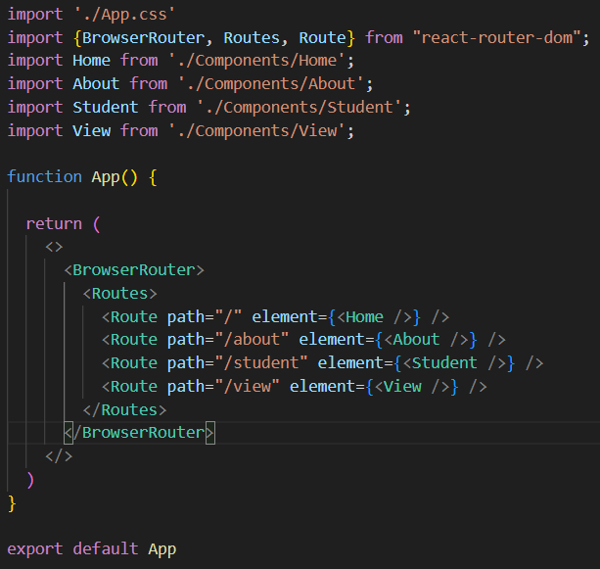
3. Adding Routing in React
Install react router dom
npm i react-router-dom
By: Kushal Vaghela

Slide 6
4. Backend Setup (Express + Node)
Initialise pakage
npm init -y
Install
npm i express mongoose cors noemone
By: Kushal Vaghela

Slide 7
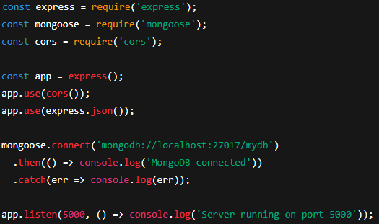
Add index.js file
By: Kushal Vaghela

Slide 8

Update package.json File
Run Back-end
npm run start
By: Kushal Vaghela

Slide 9
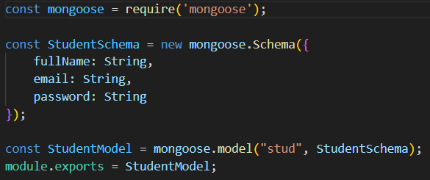
5. Describe Model
By: Kushal Vaghela

Slide 10
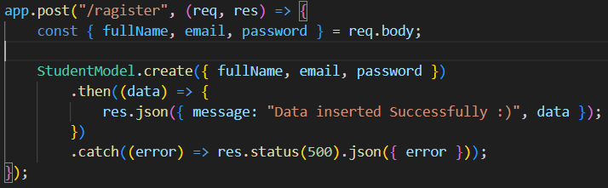
6. Implemented CRUD operations
Insert API
By: Kushal Vaghela

Slide 11
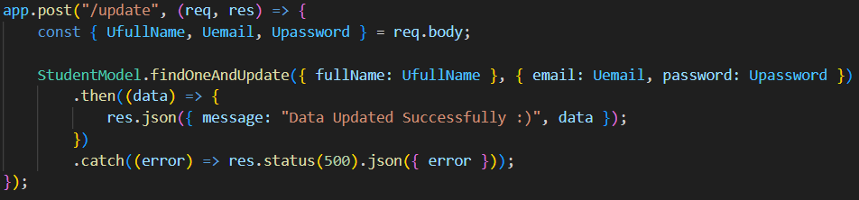
Update API
By: Kushal Vaghela

Slide 12
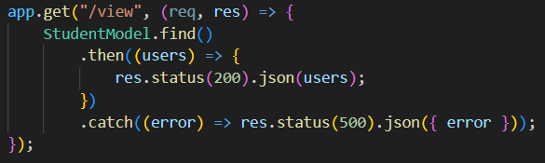
Select API
By: Kushal Vaghela

Slide 13
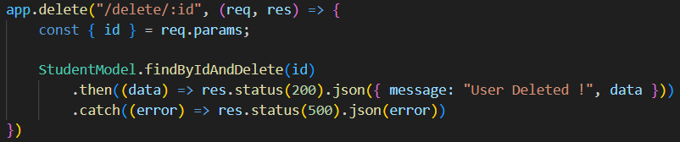
Delete API
By: Kushal Vaghela

Slide 14
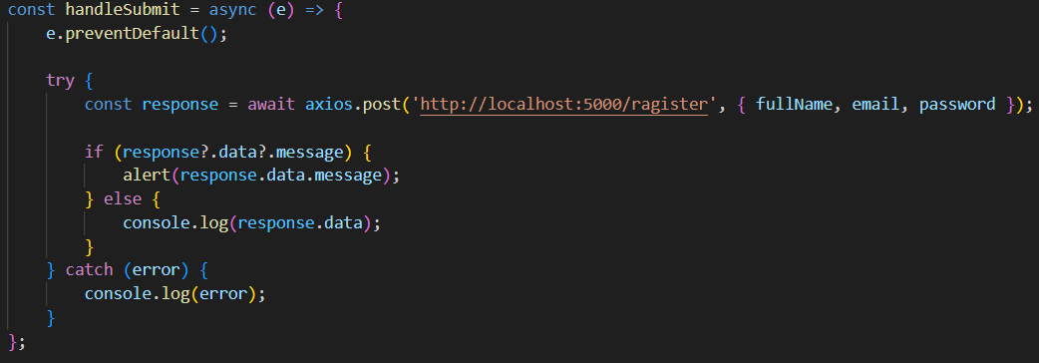
7. Connecting Front-end to Back-end
Insert
By: Kushal Vaghela

Slide 15
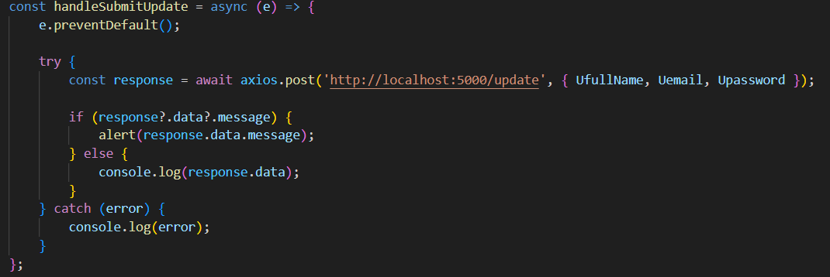
Update
By: Kushal Vaghela

Slide 16
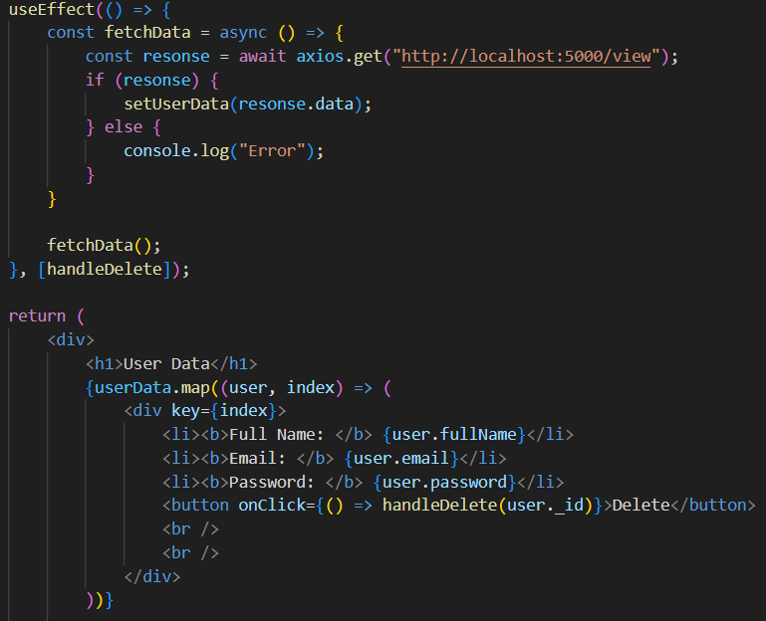
Select
By: Kushal Vaghela

Slide 17
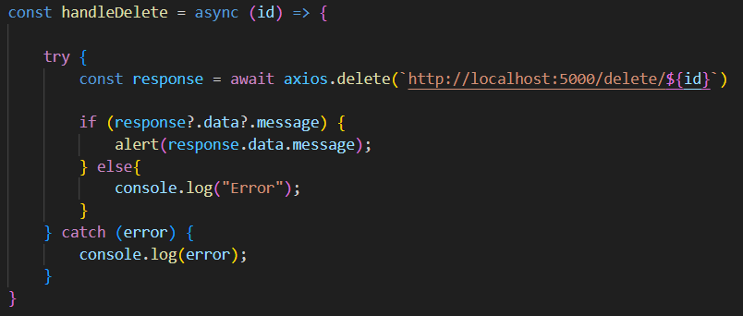
Delete
By: Kushal Vaghela

Slide 18
Q & A
|| Thank You ||
By: Kushal Vaghela

